Slide 1
Skilled Workforce: Key to Reshoring and the Mfg. Renaissance
Harry Moser
President
Reshoring Initiative

Slide 2
Connection to Reshoring
For reshoring to succeed we need to recruit and train a larger, smarter, better trained skilled workforce.
For recruitment to succeed reshoring’s success must be publicly obvious so that society, school and student understand that:
Manufacturing is returning
Manufacturing is an excellent career choice

Slide 3
Background

Slide 4
Workforce: Current Situation
82% of manufacturers: enthusiastically seeking
Engineers
CNC and 3D operators and programmers (critical)
Excess supply of non-technical university graduates (40%)
Soaring student debt
Manufacturing:
Has shifted largely to modern high tech
Is growing
Pays well! (avg. 19% more than non-mfg)

Slide 5
Trend Towards Training like in Switzerland and Germany
Apprenticeships
Strong academic and technical training
Creating, innovating, team skills
CNC, computers, 3D, CAD
Students who would do fine at the university but want a practical foundation for a degree, no tuition, earnings starting now.

Slide 6


Slide 7
New wisdom about education and training
“Post high school credential for all” replaces “College for all”
Source: Pathways to prosperity, Harvard Graduate School of Education, Feb. 2011

Slide 8
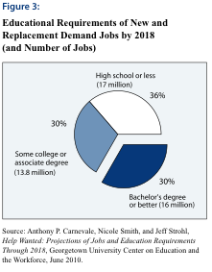

Slide 9
Community Colleges Offer a Good Solution
How Prepared for a Typical Entry Level Job in Your Company Are Applicants with a Certificate from a 2-Year College?
Source: NAM 2005 Skills Gap

Slide 10
Certificates and licenses pay off!
27 % of people with post-secondary licenses or certificates (credentials short of an associate’s degree) earn more than the average bachelor’s degree recipient.
Source: “Preparing the Workers of Today for the Jobs of Tomorrow” the Council of Economic Advisors July, 2009

Slide 11
Occupation More Important Than Degree Level
“80% of associates degree holders earn more than the Bachelor’s median income.”
“Occupation, not degree level, determines salary.”
Source: AP Carnevale (2000) (ED439743)

Slide 12
Dunwoody’s Machine Tool Technology AAS Degree Program
Minneapolis, MN
Number of June 2012 graduates: 22
Number fully employed in the industry when graduating: 21
(Recent BA/BS grads employed fulltime: 47%)
Average starting salary: $17.64 per hour
Requests to hire graduates: 450
Complaints from companies: 50

Slide 13

5-Axis Milling
Apple needed a 5-axis CNC milling expert:
$$$$

Slide 14
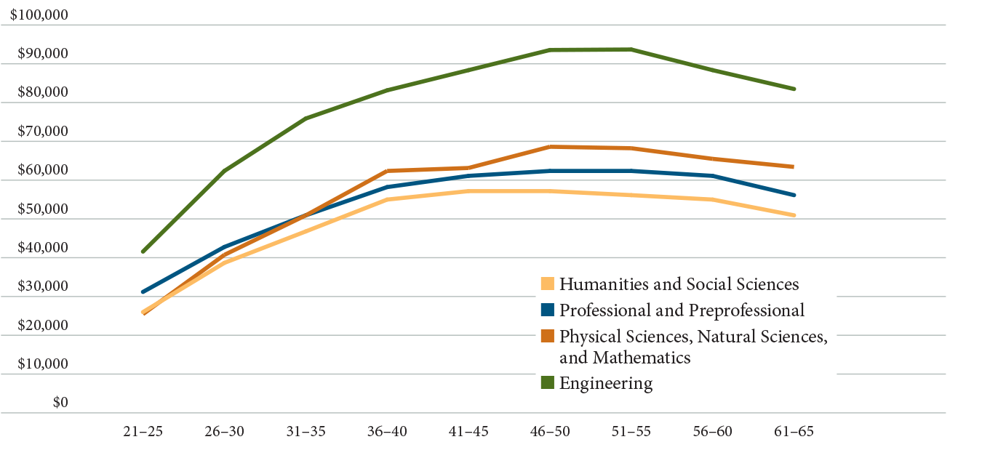
Median earnings for graduates with only baccalaureate degrees (2010-11)
Source: How Liberal Arts and Sciences Majors Fare in Employment. 2013

Slide 15
Median Annual Salary of Bachelor’s Graduates
by Field of Major and Age, 1993
TOOL & DIE
Source: 1993 National Survey of College Graduates,
NSF/SRS, NTMA, PMA/TMA.
(Data will next be released in 2003-2004)

Slide 16
Annual Income/Age

Slide 17
Tool & Die or English Major? A Million $ Decision
TOOL & DIE CUMULATIVE WEALTH ADVANTAGE
Assumptions:
1. Zero wage inflation
2. Savings = 50% of difference in income
3. Investment return of 7% per year on savings
AGE

Slide 18
ROI on Skilled Workforce Training
PERSPECTIVE | MFG. TECH, ASSOCIATES DEGREE | TOOL&DIE APPRENTICE | ENGLISH, BACHELOR’S DEGREE
WORKER | 39% | 125% | 6%
UNITED STATES | 163% | 233% | 30%
Modern Machine Shop, May 2005

Slide 19
Entrepreneurial Opportunities
BACKGROUND FOUNDED PURCHASED INHERITED UNSPECIFIED TOTAL OWNERS
APPRENTICE
GRADUATE 50% 35% 10% 40% 35%
MACHINING TRAINING
BUT NOT APPRENTICE 24% 20% 39% 20% 28%
MANUFACTURING
MANAGEMENT 11% 12% 11% 20% 11%
BUSINESS MANAGEMENT
BUT NOT MANUFACTURING 4% 24% 19% 20% 12%
OTHER 11% 8% 21% 0% 13%
TOTALS 100% 99% 100% 100% 99%
% of Total 50% 19% 24% 6% 99%
CONCLUSION: APPRENTICES & MACHINISTS FOUND COMPANIES
SOURCE: NTMA/CHARMILLES OWNER/MANAGER SURVEY. SURVEY DATE: 2001

Slide 20

INDUSTRY & COMMUNITY COLLEGE RECRUITING TOGETHER
Join the Resurgence in Wisconsin Manufacturing
Demand for skilled graduates in the machine trades is again soaring. We have received requests for more than 100 graduates in Tool and Die and Machine Tool in the past 8 to 10 months. Graduates in the machine trades are accepting jobs paying $17 to $18 an hour with excellent fringe benefits. Many third semester students are accepting jobs even as they complete coursework. The opportunities are excellent. Classes start every eight weeks.
Contact Manufacturing Technology Campus at 715-874-4604.
“CVTC has always played an important role in providing us with qualified candidates. Right now we have openings for toolmakers starting at $20.00 an hour and machinists starting over $14.00, and we can’t find them fast enough. I see this as a great career opportunity now and into the future.”
Peggy Schlagenhaufer, HR Generalist, Hutchinson Technology
www.htch.com
Eau Claire Leader Telegram
IDEA: JOINT HELP WANTED ADS IN THE
LOCAL PAPER
-1 AD
-1 OR MORE COMPANIES:
-PRAISE THE COLLEGE
-LIST CURRENT JOB OPENINGS
(“THE OPPORTUNITIES”)
-COLLEGE:
-DESCRIBES ITS PROGRAM
THAT FIT THE JOB OPENING
(“THE MEANS”)
SOURCE: CHIPPEWA VALLEY TECHNICAL COLLEGE, EAU CLAIRE, WI

Slide 21




Apprenticeship 2000

Slide 22
Why Partnership of Companies?
Strength in numbers (school)
Recruiting is shared
One program
Expenses are shared (graduation, advertisement…..)
To share knowledge
Agreement between Companies (job hoppers)
Soon or later everyone needs a favor

Slide 23
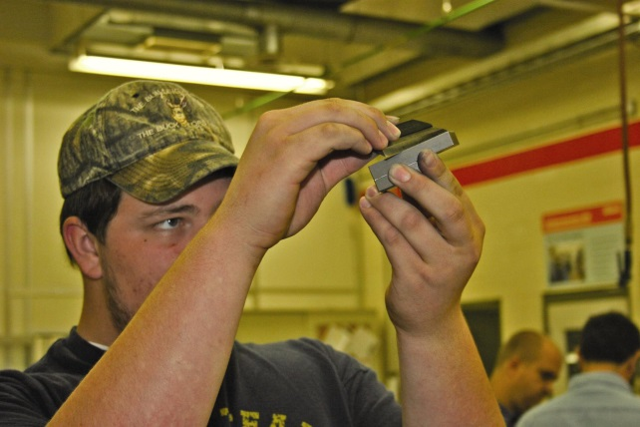
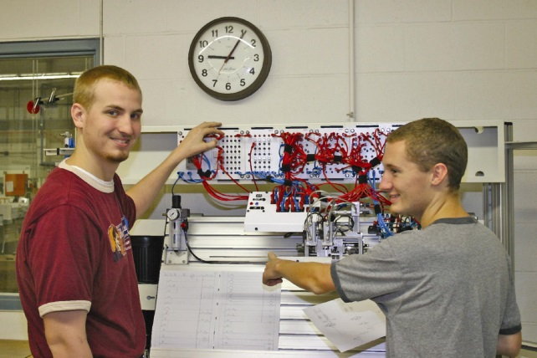
European Based Technical Training
Learning Manufacturing Skills Hands-On
Dual Training …. Theory in College, Hands-on at Sponsor Company
Scholarship ( free college and tuition)
Manufacturing Technology Degree ( AAS )
Journeyman Certificate by the Department of Labor
Guaranteed Employment After Graduation

Slide 24
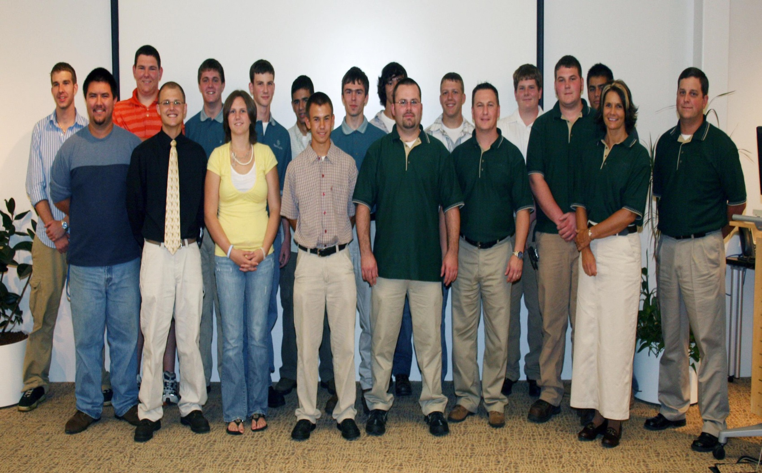
2006 Apprenticeship Signing Group

Slide 25
Statistics of Ameritech as of ~ 2007
Avg. age (all employee’s) – 34.3
Avg. age (manuf / design only ) – 30.4
Avg. tenure (all excluding Steve ) – 6.74 yrs
avg tenure ( all, excl. Steve, and (2) 1st year apprentices) – 7.37 yrs
Avg wage / hr ( manf + design ) - $19.07
Current apprentice/grads
Manuf/design = 33%
Total company = 28%

Slide 26
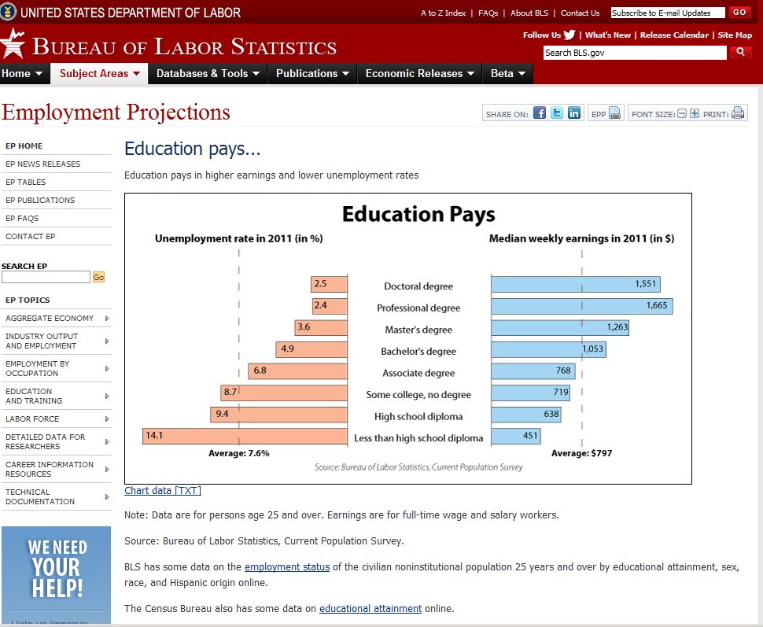
Simple Solutions to Improving Image Nationally

Slide 27
Adopt Better Terminology
Current | Proposed
High skill | Academic skill
Middle skill | Technical skill
Low skill | Manual skill

Slide 28
And Improve Image Locally
Issue | Solution
“Trades” and “vocations” image | Call them “Professions”
“Middle skills” | “Technical Skills”
Manufacturing career image due to offshoring | Industry collect and media report the local reshoring case of the month. Use our Case Studies feature.

Slide 29
Mour Recommendations
Local:
Document that training pays locally
Document and promote local reshoring successes
Skilled “professions” not “trades” or “vocations”
Show that much of the university degree income difference is tied to family socio-economics
ROI on training vs. specific degree fields
National:
On-line library of promotional material.
Apprentice loans like student loans
SBA loans require apprentice hires

Slide 30
Our Programs
The Reshoring Initiative would be pleased to advise states, cities or companies in adopting one of our skilled workforce programs:
National Skilled Workforce - ideas for national high payback skills and training actions
Skilled Workforce Program – ideas for local high payback skills programs

